Slide 1
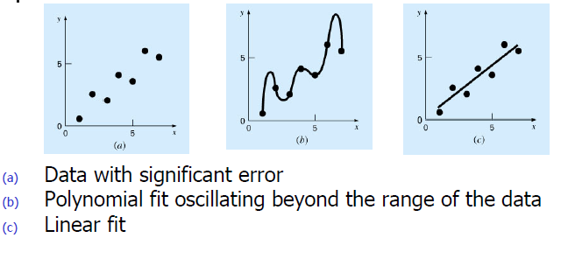
Linear regression and Curve Fitting
Describes techniques to fit curves to discrete data in order to obtain intermediate estimates
There are two general approaches to curve fitting:
There is a significant degree of scatter to the data
  Find a curve that represents the general trend of the data.
The data is very precise
  Find a curve (or series of curves) that passes through the points
Variable Data Example

Slide 2

Linear Regression Analysis…
Regression analysis is used to predict the value of one variable (the dependent variable) on the basis of other variables (the independent variables).
Dependent variable: denoted Y
Independent variables: denoted X₁, X₂, …, X_{k}
If we only have ONE independent variable, the model is
which is referred to as simple linear regression. We would be interested in estimating β₀ and β₁ from the data we collect.
17.<number>

Slide 3

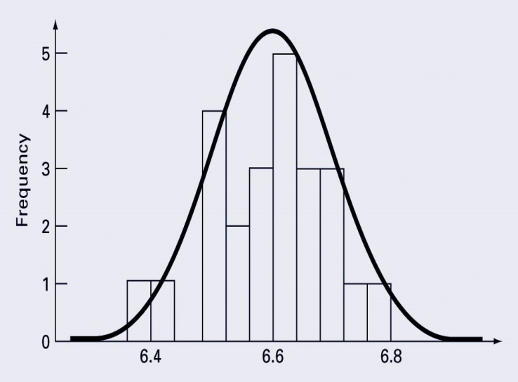
Linear Regression Analysis
Variables:
X = Independent Variable (we provide this)
Y = Dependent Variable (we observe this)
Parameters:
β₀ = Y-Intercept
β₁ = Slope
ε ~ Normal Random Variable
17.<number>

Slide 4
Effect of Larger Values of σ_{ε}
Lower vs. Higher
Variability
House
Price
25K$
House Price = 25,000 + 75(Size) +
House size
Same square footage, but different price points
17.<number>

Slide 5
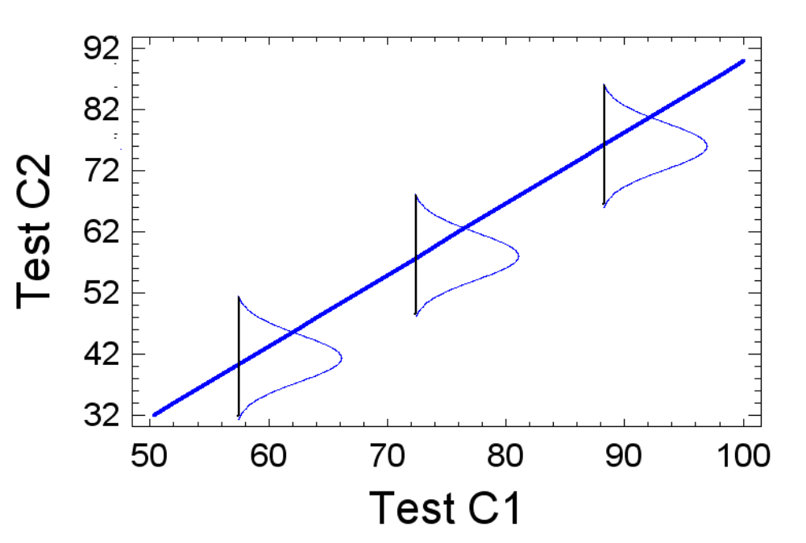
Theoretical Linear Model
17.<number>

Slide 6
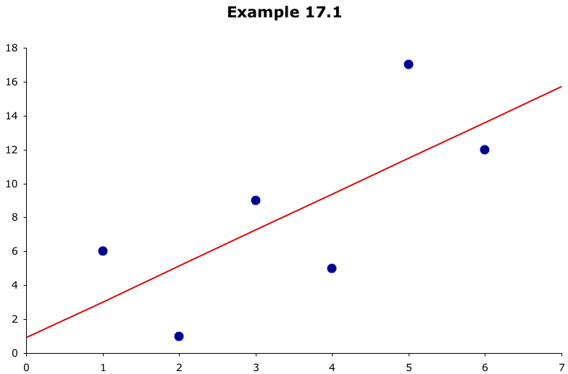
Which line has the best “fit” to the data?
?
?
?
17.<number>

Slide 7
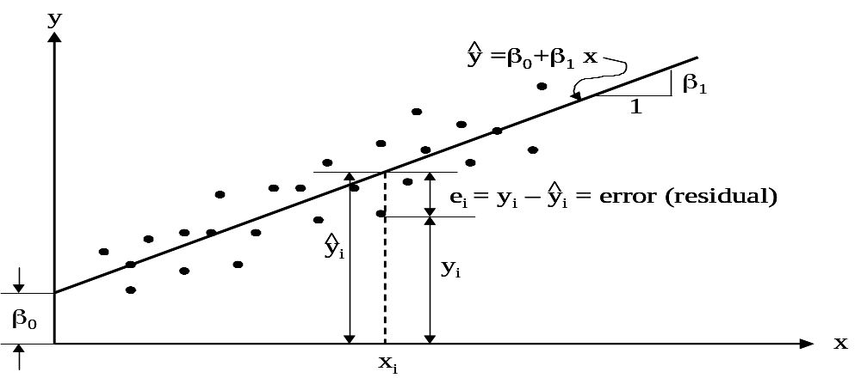
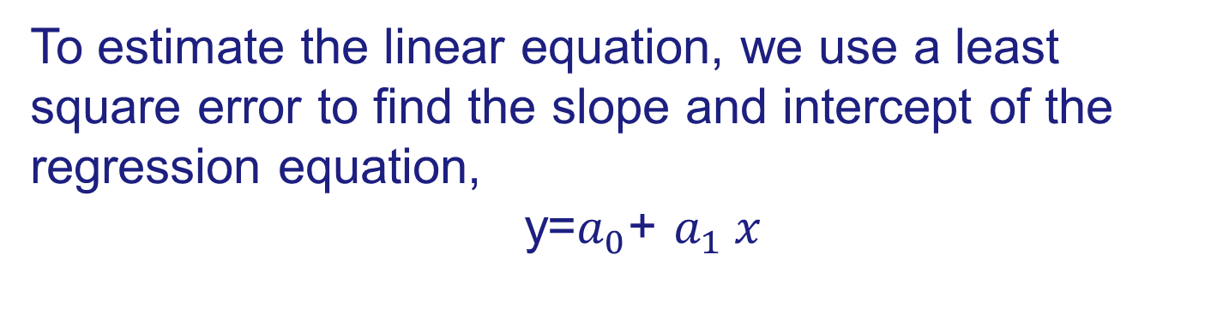
Error
Considering an arbitrary straight line, y =β₀+β₁ x, is to be fitted through these data points. The question is “Which line is the most representative”?

Slide 8
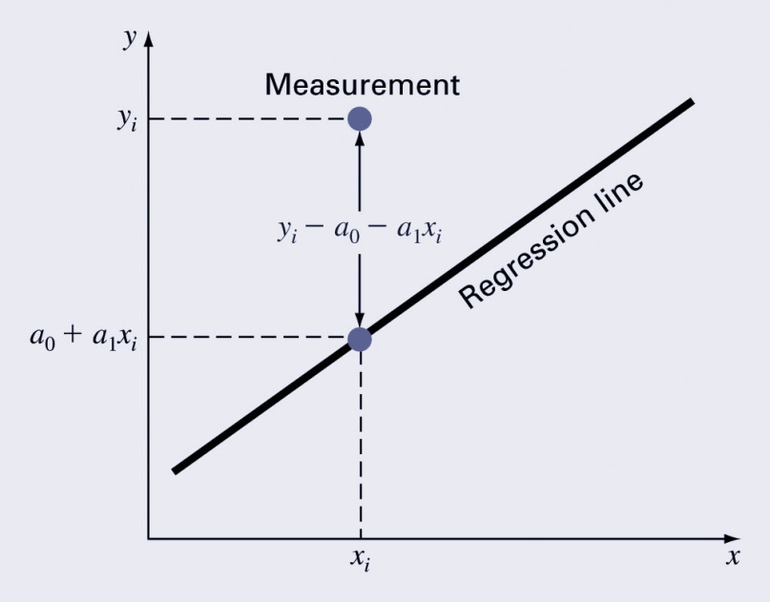
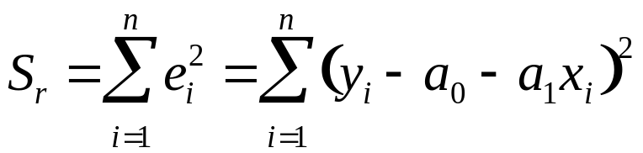
Linear Least-Squares Regression
Linear least-squares regression is a method to determine the “best” coefficients in a linear model for given data set.
“Best” for least-squares regression means minimizing the sum of the squares of the estimate residuals. For a straight line model, this gives:
This method will yield a unique line for a given set of data.

Slide 9
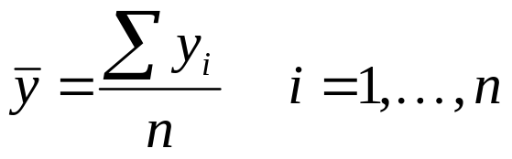
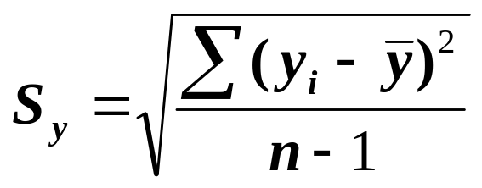
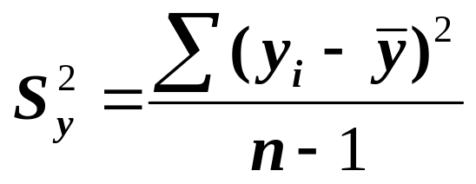
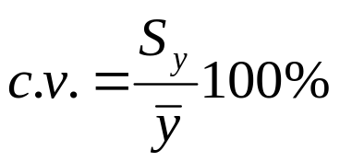
Simple Statistics
In sciences, if several measurements are made of a particular quantity, additional insight can be gained by summarizing the data in one or more well chosen statistics:
Arithmetic mean - The sum of the individual data points (y_{i}) divided by the number of points.
Standard deviation – a common measure of spread for a sample
or variance
Coefficient of variation –
quantifies the spread of data (similar to relative error)

Slide 10
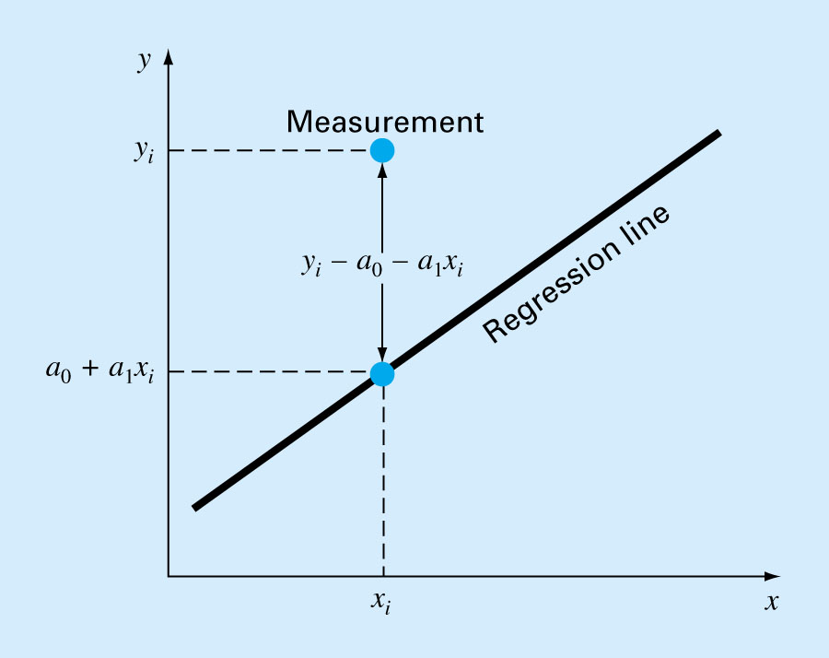
Linear Regression
Fitting a straight line to a
set of paired observations:
(x₁, y₁), (x₂, y₂),…,(x_{n}, y_{n})
y_{i} : measured value
e : error
y_{i} = a₀ + a₁ x_{i} + e
e = y_{i} - a₀ - a₁ x_{i}
a₁ : slope
a₀ : intercept
e Error
Line equation
y = a₀ + a₁ x

Slide 11
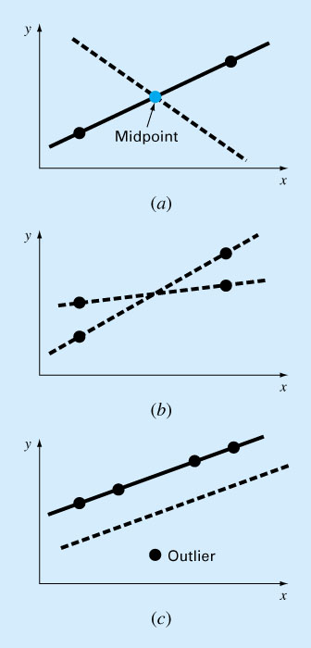
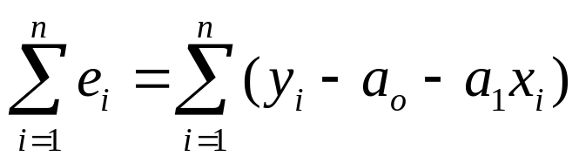
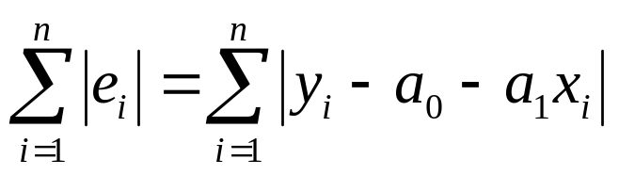
Choosing Criteria For a “Best Fit”
Minimize the sum of the residual errors for all available data?
Inadequate!
(see ➔➔➔)
Sum of the absolute values?
Inadequate!
(see ➔➔➔)
How about minimizing the distance that an individual point falls from the line?
This does not work either! see ➔➔➔
Regression
line

Slide 12
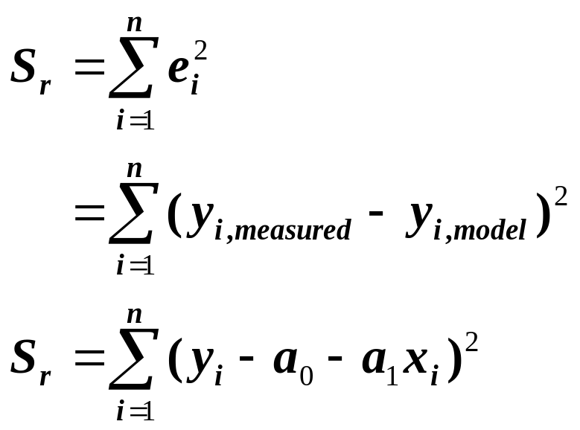
Best strategy is to minimize the sum of the squares of the residuals between the measured-y and the y calculated with the linear model:
Yields a unique line for a given set of data
Need to compute a₀ and a₁ such that S_{r} is minimized!
e Error

Slide 13
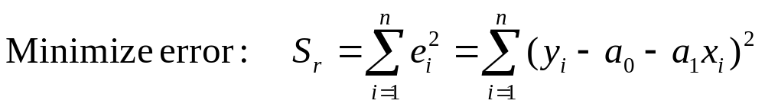
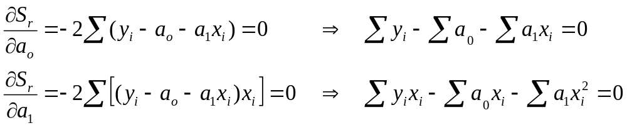
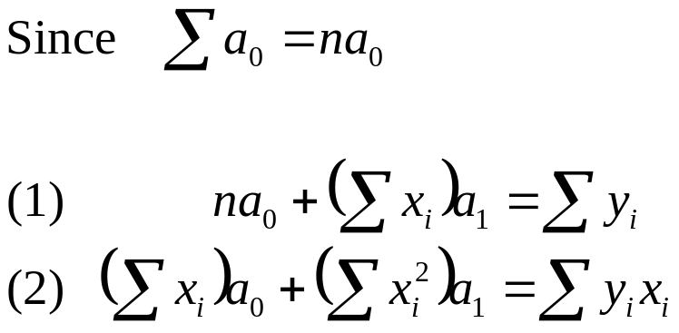
Least-Squares Fit of a Straight Line
Normal equations which can be solved simultaneously

Slide 14
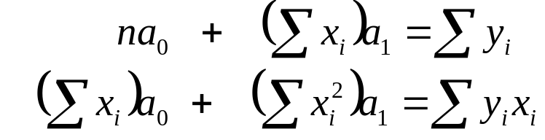
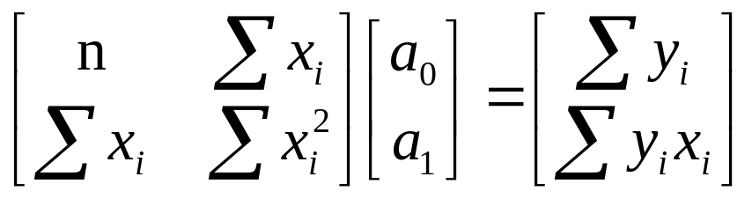
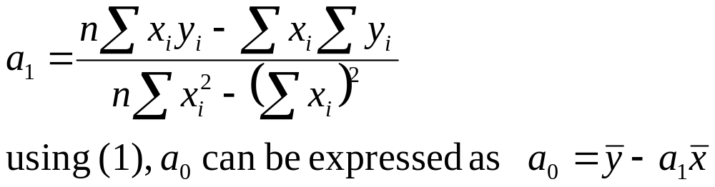
Least-Squares Fit of a Straight Line
Normal equations which can be solved simultaneously
Mean values

Slide 15
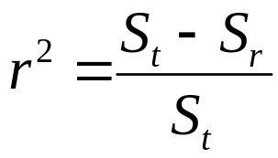
Goodness of fit
If the total sum of the squares around the mean for the dependent variable, y, is S_{t} and the sum of the squares of residuals around the regression line is S_{r} , then S_{t}-S_{r} quantifies the improvement or error reduction due to describing data in terms of a straight line rather than as an average value.
The coefficient of determination r² is the difference between the sum of the squares of the data residuals and the sum of the squares of the estimate residuals, normalized by the sum of the squares of the data residuals:
r² represents the percentage of the original uncertainty explained by the model.

Slide 16
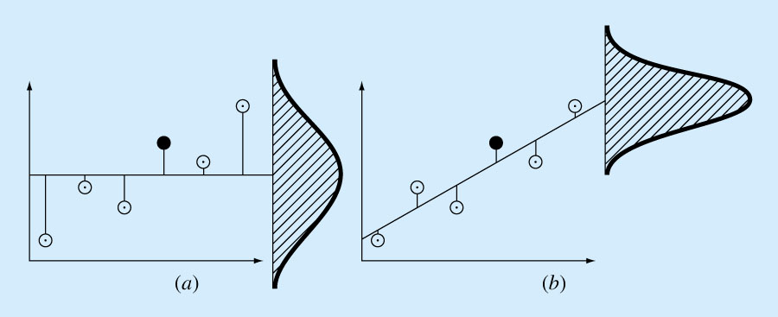
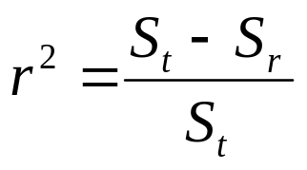
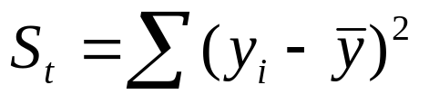
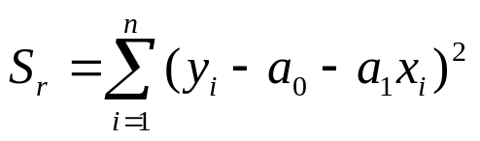
“Goodness” of our fit
The spread of data
around the mean
around the best-fit line
Notice the improvement in the error due to linear regression
S_{r} = Sum of the squares of residuals around the regression line
S_{t} = total sum of the squares around the mean
(S_{t} – S_{r}) quantifies the improvement or error reduction due to describing data in terms of a straight line rather than as an average value.
For a perfect fit S_{r}=0 and r = r² = 1
signifies that the line explains 100 percent of the variability of the data.
For r = r² = 0 ➔ S_{r}=S_{t} ➔ the fit represents no improvement
r : correlation coefficient
r² : coefficient of determination

Slide 17
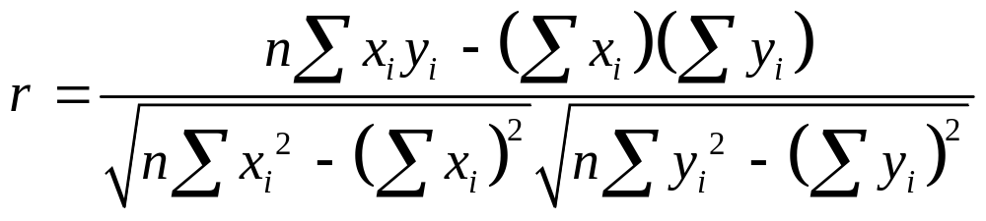
Correlation of Coefficient

Slide 18
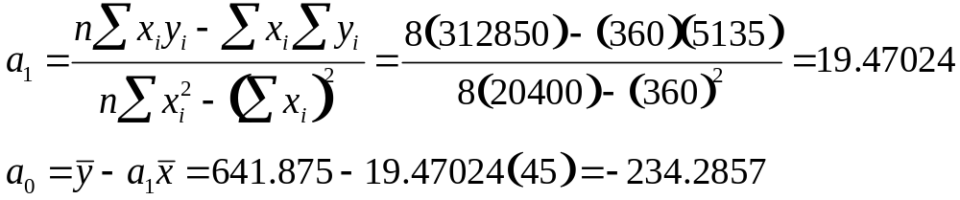
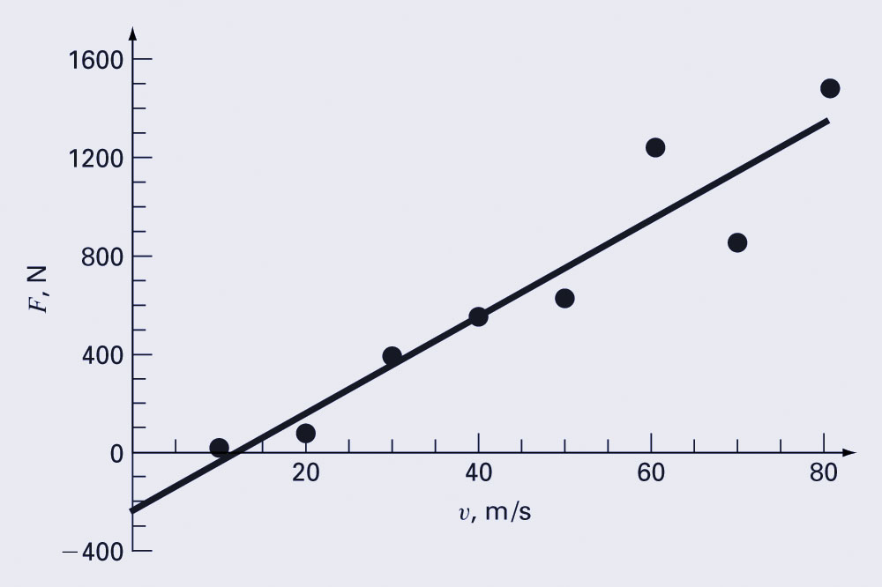
Example
 | V (m/s) | F (N)
i | x_{i} | y_{i} | (x_{i})² | x_{i}y_{i}
1 | 10 | 25 | 100 | 250
2 | 20 | 70 | 400 | 1400
3 | 30 | 380 | 900 | 11400
4 | 40 | 550 | 1600 | 22000
5 | 50 | 610 | 2500 | 30500
6 | 60 | 1220 | 3600 | 73200
7 | 70 | 830 | 4900 | 58100
8 | 80 | 1450 | 6400 | 116000
Σ | 360 | 5135 | 20400 | 312850

Slide 19
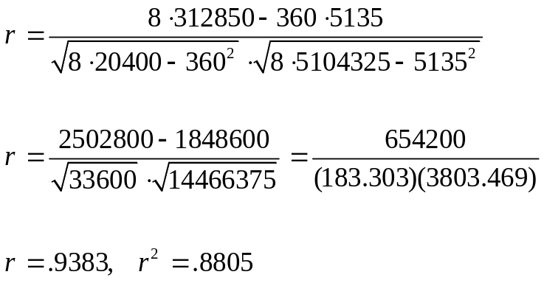
Example
 | V (m/s) | F (N)
i | x_{i} | y_{i} | x_{i}² | y_{i}² | x_{i}y_{i}
1 | 10 | 25 | 100 | 625 | 250
2 | 20 | 70 | 400 | 4900 | 1400
3 | 30 | 380 | 900 | 144400 | 11400
4 | 40 | 550 | 1600 | 302500 | 22000
5 | 50 | 610 | 2500 | 372100 | 30500
6 | 60 | 1220 | 3600 | 1488400 | 73200
7 | 70 | 830 | 4900 | 688900 | 58100
8 | 80 | 1450 | 6400 | 2102500 | 116000
Σ | 360 | 5135 | 20400 | 5104325 | 312850
88.05% of the original uncertainty
has been explained by the
linear model

Slide 20
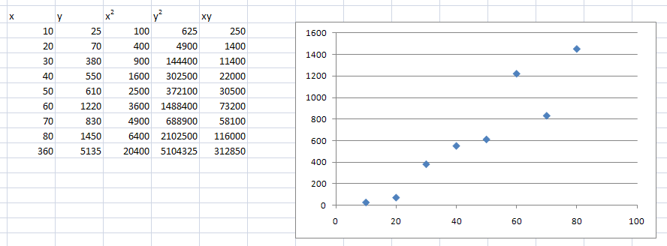
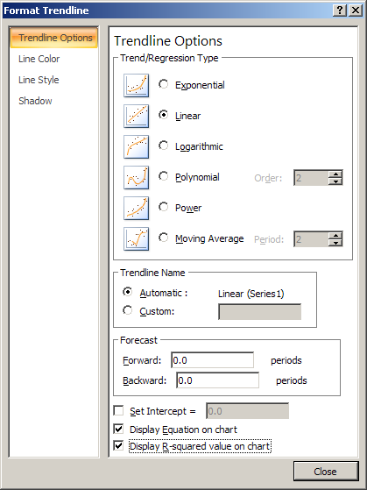
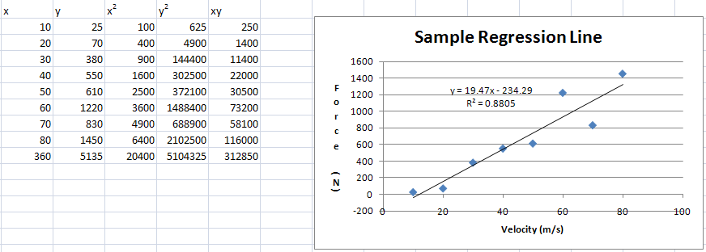
Plotting in EXCEL
x and y values were selected and a scatter plot inserted. Right click on any data point and select insert trendline. Select linear, and at the bottom, display equation on chart and display R-squared value on chart.

Slide 21
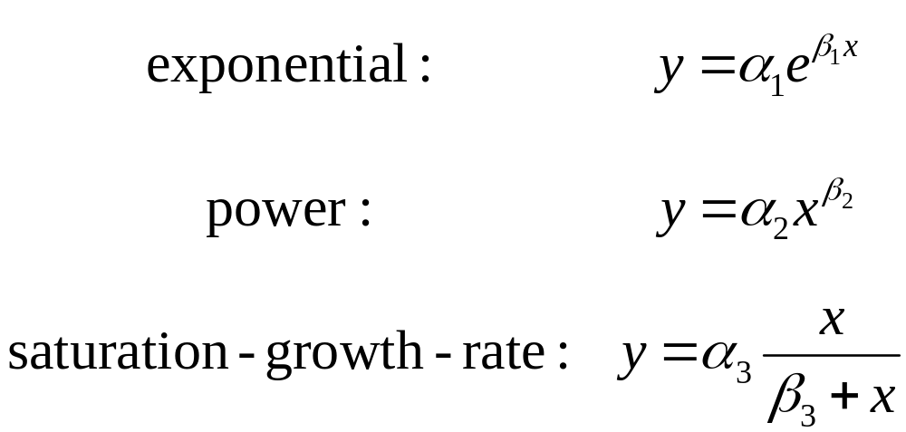
Nonlinear Relationships
Linear regression is predicated on the fact that the relationship between the dependent and independent variables is linear - this is not always the case.
Three common examples are:

Slide 22
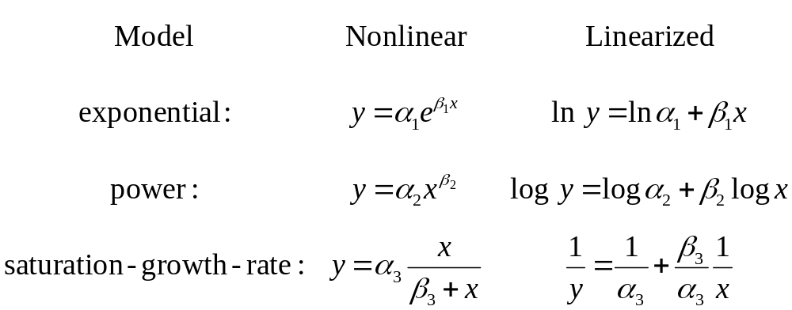
Linearization of Nonlinear Relationships
One option for finding the coefficients for a nonlinear fit is to linearize it. For the three common models, this may involve taking logarithms or inversion:

Slide 23
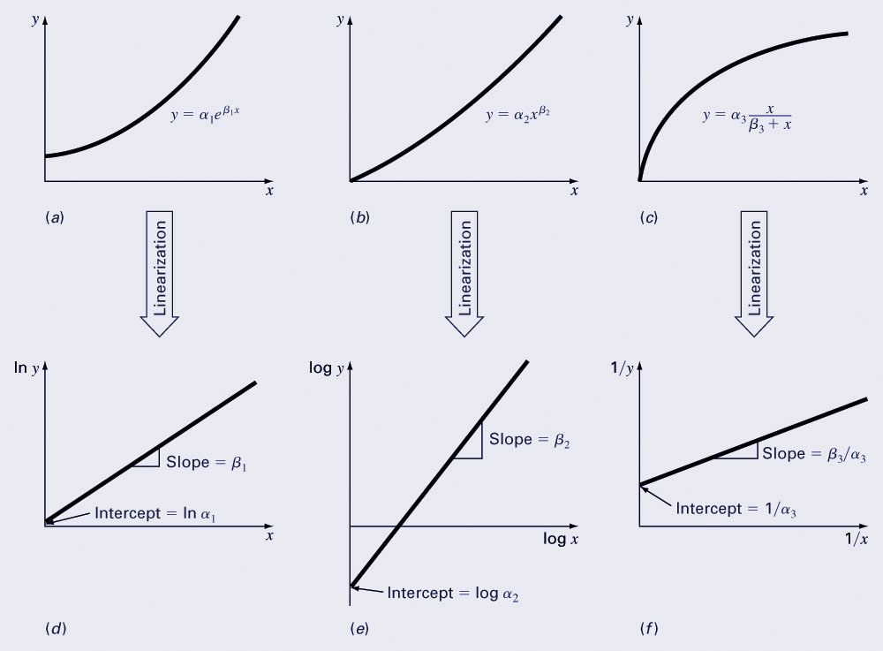
Transformation Examples

